Slide 1
Real time systems
Pravin Y Pawar

Slide 2
Responding in Real Time
Few Examples
World is now operating more and more in the now
Ability to process data as it arrives (processing data in the present)
Your twitter friend / celebrity posts a tweet, and you see it almost immediately…
You are tracking flights around New Delhi Live…
You are using the nseindia.com tracker page to track your favourite stocks…

Slide 3
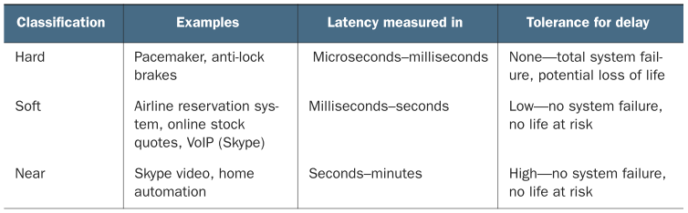
Classification of Real Time Systems
Source : Streaming Data by Andrew Psaltis

Slide 4
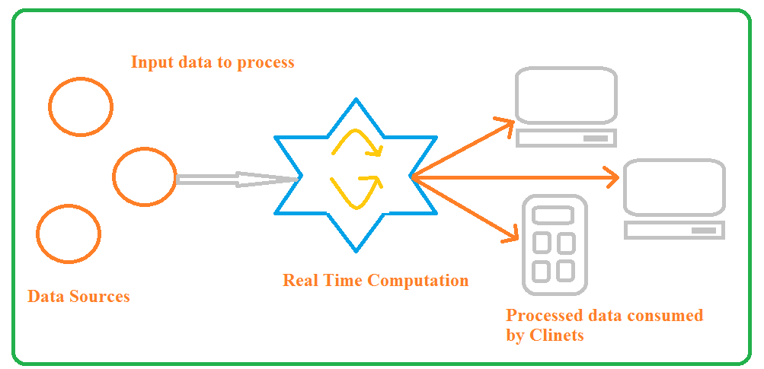
A generic real-time system with consumers
Consumers are connected to the service online
Source : Adapted from Streaming Data by Andrew Psaltis

Slide 5
A generic real-time system with consumers(2)
Examples discussion
In each of the examples, is it reasonable to conclude that
the time delay may only last for seconds?
no life is at risk?
an occasional delay for minutes would not cause total system failure?

Slide 6
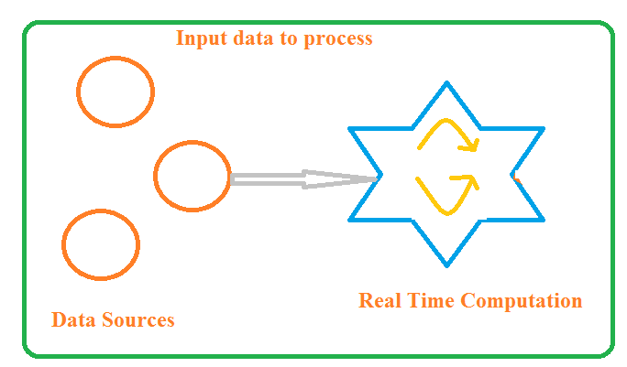
A generic real-time system without consumers
Consumers are not connected to the service but service continues its operation
Source : Adapted from Streaming Data by Andrew Psaltis

Slide 7
A generic real-time system without consumers(2)
Examples discussion
A tweet is posed on twitter
The Live Flight Tracking service tracking flights
Real time quotes monitoring application is tracking the stock quotes
Does focusing on the data processing and taking consumers of the data out of picture change your answer?
Difference between soft real time and near real time becoming blurry
Together they are just termed as real time

Slide 8
Difference between real-time and streaming systems
Pravin Y Pawar

Slide 9
Real-time systems again
Soft or near real time systems
Based on the delay experience by consumers – soft or near real time systems
Difference between them is blurring , hard to distinguish
Two parts are present in larger picture
Source : Adapted from Streaming Data by Andrew Psaltis

Slide 10
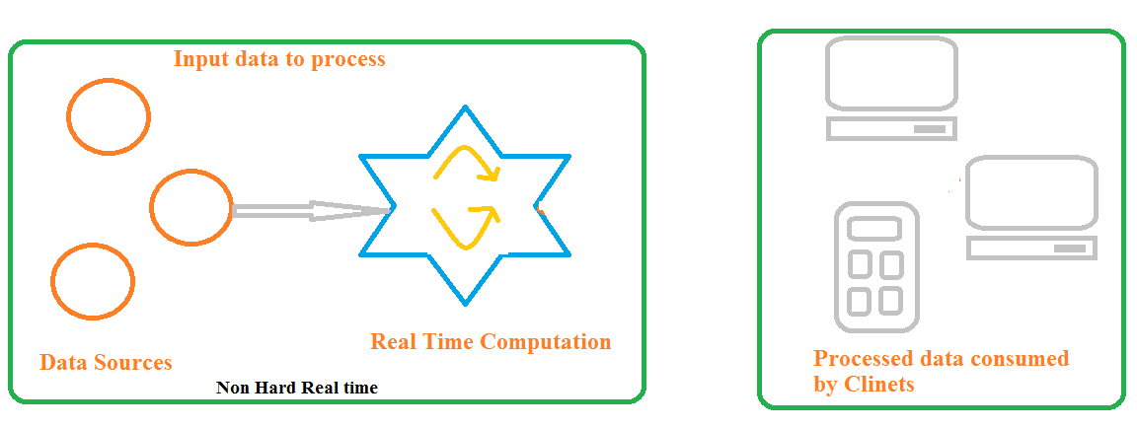
Breaking the real time system
Lets divide the real time system into two parts
Left part Non-hard real-time system
Right part client consuming data
Source : Adapted from Streaming Data by Andrew Psaltis

Slide 11
Streaming Data Systems
Defined
Computation part of real time system operating in non-hard real-time manner
But Client not consuming the processed data
Due to network issues, application requirement, no application running
Clients consume data when they need it
Streaming data system
Non-hard real time system with clients that consume data when they need it

Slide 12
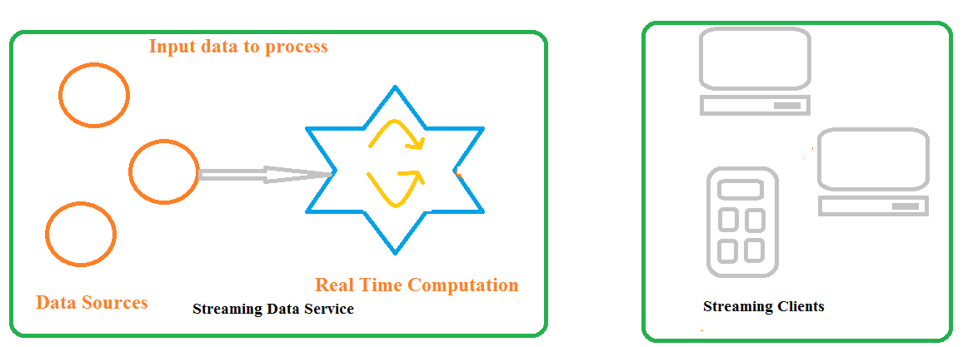
First view of Streaming Data System
Source : Adapted from Streaming Data by Andrew Psaltis

Slide 13
Streaming Data Systems(2)
Examples revisited
Lets divide the earlier discussed examples into two parts and identify the streaming part of it
Twitter
A streaming system that processes tweets and allows clients to request the tweets when needed
Flight Tracking System
A streaming system that processes most recent flight status data and allows client to request the latest data for particular flight
Real time Quotes Tracking System
A streaming system that processes the price quotes of stocks and allows clients to request the latest quote of stock

Slide 14
Difference between Batch Processing and Stream Processing
Pravin Y Pawar

Slide 15
Batch Processing System
Defined
An efficient way of processing high volumes of data is where a group of transactions is collected over a period of time
Data is collected, entered, processed and then the batch results are produced
Hadoop is focused on batch data processing
Requires separate programs for input, process and output
Huge volume of storage is required
Data is sorted and then processed in sequential manner
No hard timelines defined
Sequential jobs are executed in repeated manner over fixed interval
An example is payroll and billing systems

Slide 16
Streaming Data Systems
Defined
Involves a continual input, process and output of data
Data must be processed in a small time period (or near real time)
Apache Storm, Spark Stream processing are frameworks meant for the same
Allows an organization the ability to take immediate action for those times when acting within seconds or minutes is significant
No storage required if event need not be stored
Data is processed as and when its made available to the system
Processing has to happen in fixed / hard time lines
Examples Radar systems, customer services and bank ATMs

Slide 17
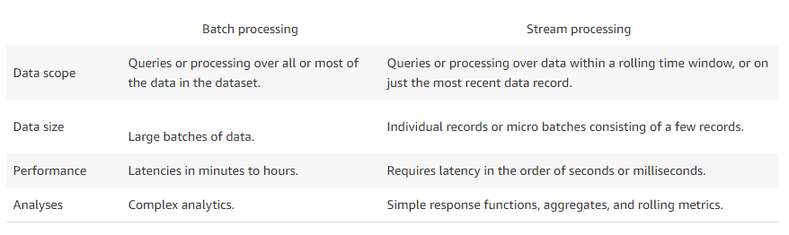
Difference
Source : https://aws.amazon.com/streaming-data/

Slide 18
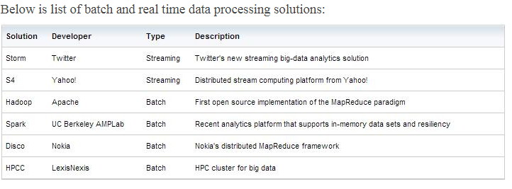
Frameworks
Source : https://www.datasciencecentral.com/profiles/blogs/batch-vs-real-time-data-processing

Slide 19
Streaming Data Applications
Pravin Y Pawar

Slide 20
Why is stream Processing needed?
Reason 1
Some data naturally comes as a never-ending stream of events. To do batch processing, you need to store it, stop data collection at some time and processes the data.
Then you have to do the next batch and then worry about aggregating across multiple batches.
In contrast, streaming handles never ending data streams gracefully and naturally.
You can detect patterns, inspect results, look at multiple levels of focus, and also easily look at data from multiple streams simultaneously.
Source : https://medium.com/stream-processing/what-is-stream-processing-1eadfca11b97

Slide 21
Why is stream Processing needed? (2)
Reason 2
Stream processing naturally fit with time series data and detecting patterns over time.
For example, if you are trying to detect the length of a web session in a never-ending stream ( this is an example of trying to detect a sequence).
It is very hard to do it with batches as some session will fall into two batches.
Stream processing can handle this easily.

Slide 22
Why is stream Processing needed? (3)
Reason 3
Batch processing lets the data build up and try to process them at once while stream processing process data as they come in hence spread the processing over time.
Hence stream processing can work with a lot less hardware than batch processing.
Furthermore, stream processing also enables approximate query processing via systematic load shedding.
Hence stream processing fits naturally into use cases where approximate answers are sufficient.

Slide 23
Why is stream Processing needed? (4)
Reason 4
Finally, there are a lot of streaming data available ( e.g. customer transactions, activities, website visits) and they will grow faster with IoT use cases ( all kind of sensors).
Streaming is a much more natural model to think about and program those use cases.

Slide 24
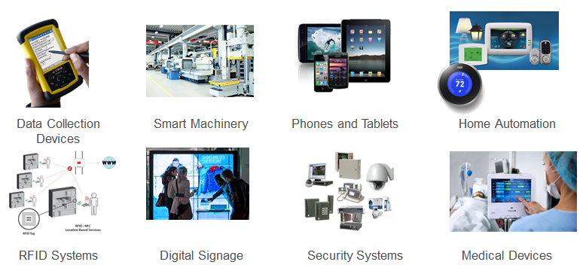
Streaming Data Sources
Source : https://mapr.com/blog/real-time-streaming-data-pipelines-apache-apis-kafka-spark-streaming-and-hbase/

Slide 25
Streaming Data Examples
Sensors in transportation vehicles, industrial equipment, and farm machinery send data to a streaming application. The application monitors performance, detects any potential defects in advance, and places a spare part order automatically preventing equipment down time.
A financial institution tracks changes in the stock market in real time, computes value-at-risk, and automatically rebalances portfolios based on stock price movements.
A real-estate website tracks a subset of data from consumers’ mobile devices and makes real-time property recommendations of properties to visit based on their geo-location.
A solar power company has to maintain power throughput for its customers, or pay penalties. It implemented a streaming data application that monitors of all of panels in the field, and schedules service in real time, thereby minimizing the periods of low throughput from each panel and the associated penalty payouts.
A media publisher streams billions of click stream records from its online properties, aggregates and enriches the data with demographic information about users, and optimizes content placement on its site, delivering relevancy and better experience to its audience.
An online gaming company collects streaming data about player-game interactions, and feeds the data into its gaming platform. It then analyzes the data in real-time, offers incentives and dynamic experiences to engage its players.
Source : https://aws.amazon.com/streaming-data/

Slide 26
Who is using Stream Processing?
Streaming Data Use cases
Algorithmic Trading, Stock Market Surveillance,
Smart Patient Care
Monitoring a production line
Supply chain optimizations
Intrusion, Surveillance and Fraud Detection
Most Smart Device Applications: Smart Car, Smart Home ..
Smart Grid — (e.g. load prediction and outlier plug detection see Smart grids, 4 Billion events, throughout in range of 100Ks)
Traffic Monitoring, Geofencing, Vehicle, and Wildlife tracking — e.g. TFL London Transport Management System
Sports analytics — Augment Sports with real-time analytics
Context-aware promotions and advertising
Computer system and network monitoring
Predictive Maintenance, (e.g. Machine Learning Techniques for Predictive Maintenance)
Geospatial data processing
Source : https://medium.com/stream-processing/what-is-stream-processing-1eadfca11b97

Slide 27
Usage of Stream Processing
Pravin Y Pawar

Slide 28
Uses of Stream Processing
Example Applications
Fraud detection applications monitors the usage of credit cards for detection of unexpected patterns
Stock trading system looks for the opportunities of stock values and execute the trades based on those patterns
Manufacturing systems keeps an eye on the assembly / manufacturing process for the defective or malfunctioning machine
Intelligence systems can keep track of activities of aggressors and raise alarm if something unusual is noticed about them
Etc.
Concepts : Designing Data Intensive Applications by Martin Kleppmann

Slide 29
Other Applications
Complex Event Processing CEP
Developed in 90’s
Can specify rules to search for certain patterns of events in streams
Can use programming constructs or GUIs to specify the conditions for patterns
Outcomes can be displayed visually or alerts can be raised when condition is fulfilled
Outcomes are complex event in nature, hence is the name
Continuous queries model is used for identifying patterns
Query is always running
Events flows through it
Examples
Esper
IBM Infosphere
TIBCO StreamBase
Oracle CEP

Slide 30
Other Applications (2)
Stream Analytics
Recent application area
Difference between CEP and Streaming Analytics diminishing
More oriented towards aggregations and metrics over large number of events
Measuring rate at which system heart-beat messages are transmitted
Calculation rolling averages for certain periods
Comparing the statistics about two or more streams
Usually windows of time are used
Techniques used can produce exact outcomes or probabilistic outcomes
Examples
Apache Storm
Spark Streaming
Flink
Apache Samza

Slide 31
Other Applications (3)
Materialized Views
Materialized views are kind of dependent applications like caches, search index, data warehouses etc.
When something changes in underlying systems like databases, all dependents needs to be updated as well
Can be achieved by tracking what all things are changing in the applications and derived apps can be updated based on tracked changes

Slide 32
Other Applications (4)
Stream Searching
CEP mostly monitors multiple event together, correlation between the incoming events
Sometimes individual events also needs to be monitored for certain complex conditions
For example,
User is interested to get informed when a particular property matching his requirement and budget is listed for sale / rent
User is interested to get informed about the availability of the products which are currently unavailable for sale

Slide 33
Sources of Streaming Data
Pravin Y Pawar

Slide 34
Streaming Data Sources
1. Operational Monitoring
Operational Monitoring
Ex: Tracking the performance of the physical systems that power the Internet
Temperature of the processor, speed of the fan and the voltage draw of their power supplies , state of their disk drives ( processor load, network activity, and storage access times ) etc…
Data is collected and aggregated in real time
Source : Adapted from Real-Time Analytics , Byron Ellis

Slide 35
Streaming Data Sources (2)
2. Web Analytics
Web Analytics - track activity on a website
Circulation numbers of a newspaper, the number of unique visitors for a webpage etc
Structure of websites and their impact on various metrics of interest – A/B Testing – done in sequence vs parallel
Applications – aggregation for billing – product recommendations (NetFlix)

Slide 36
Streaming Data Sources (3)
3. Online Advertising
Contributes immensely for the large and growing portion of traffic.
A visitor arrives at a website via a modern advertising exchange
Call is made to a number of bidding agencies (perhaps 30 or 40 at a time), who place bids on the page view in real time by the exchange
Auction is run, and the advertisement from the winning party is displayed
(1) to (3) happens while the rest of the page is loading; the elapsed time is less than about 100 milliseconds
A page with several advertisements needs simultaneous effort for each advertisements

Slide 37
Streaming Data Sources (4)
4. Social Media
Sources like twitter, facebook, Instagram, google+, flickr….
Data is collected and disseminated in real time
“In 2011, Twitter users in New York City received information about an earth-quake outside of Washington, D.C. about 30 seconds before the tremors struck New York itself “
Data highly unstructured and some form of “natural language” data that must be parsed, processed, and not well understood by automated systems

Slide 38
Streaming Data Sources (5)
5. Mobile data and IoT
Measure the physical world
Wristband that measures sleep activity
Trigger an automated coffee maker when the user gets a poor night’s sleep and needs to be alert the next day.

Slide 39
Thank You!
In our next session: Difference between Batch Processing and Stream Processing

